Slide 1

International health

Slide 2
Timeline
1851
1881
1890
1902
1859
1866
1874
Proposal for international port health notification
1891
Called for sanitary agreements and conventions
Formation of PASB by 11 countries
First International Sanitary Congress (Paris)
Second International Sanitary Congress (Paris)
Third International Sanitary Congress (Constantinople)
Fourth International Sanitary Congress (Vienna)
5th International Sanitary Congress (Washington DC)
1st Conference of American States (Washington DC)
2nd Conference (Mexico City)
1st Pan-American Sanitary Convention (Washington DC)

Slide 3
Yellow Fever Epidemic
1870s – Epidemic in Brazil, Paraguay, Uruguay, Argentina
⮕ Over 15,000 deaths in Buenos Aires
1878 – Spread to US via maritime contact
⮕ Outbreaks along the Mississippi River
1881 – Carlos Finlay (Cuba)
⮕ Hypothesized Aedes aegypti mosquito as yellow fever vector

Slide 4
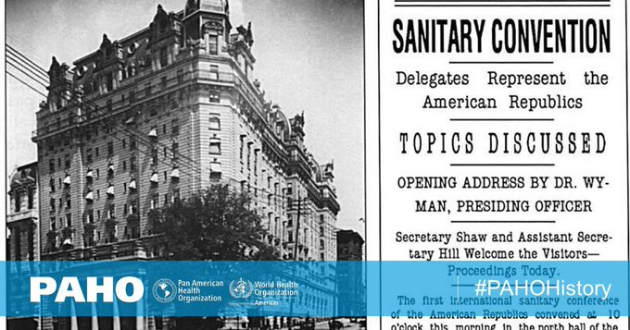
First International sanitary conference
1851 – Paris
European countries – Austria, France, Great Britain, Greece, Portugal, Russia, Spain, Italy (sovereign states – Sardinia, two sicilies, Papal states, Tuscany) and Turkey
To introduce some order and uniformity into quarantine measures which varied from country to country.
The conference lasted six months with no lasting results.

Slide 5
First International sanitary conference
Despite the many difficulties involved, an international sanitary code was prepared, comprising 137 articles dealing with cholera, plague and yellow fever.
The sanitary code never came into force as it was ratified by only three countries - France, Portugal and Sardinia of which Portugal and Sardinia withdrew in 1865.
The 1851 conference was followed in rapid succession by further conferences - no less than 10 conferences took place between 1851 and 1902, but they were equally unable to reach an agreement on quarantine measures

Slide 6
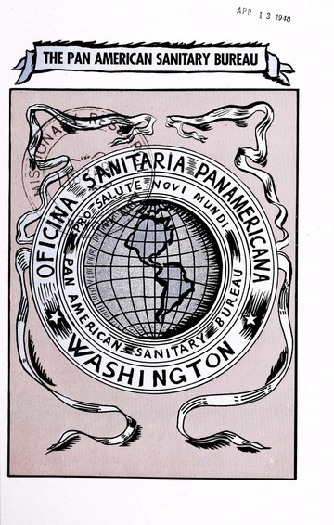
Pan American Sanitary Bureau (1902)
Intended to coordinate quarantine procedures in the American States.
In 1924 an important document was signed by the American Republic namely “The Pan American Sanitary Code” which is still in force between the States.
In 1947, the Bureau was reorganized and the organization was called the Pan American Sanitary Organization (PASO).

Slide 7
Pan American Sanitary Bureau (1902)
In 1949, an agreement was reached whereby the PASO would serve as the WHO Regional Office for the Americas.
In 1958, the name was changed to Pan American Health Organization (PAHO) Over the years, PAHO has grown from a small information centre to a major health agency with its headquarters in Washington, D.C.
The Pan American Sanitary Bureau was the World’s first international health agency.

Slide 8
Timeline
1902
1905
Formation of PASB by 11 countries
Successes in Cuba, Panama Canal, Mexico
1907
Urged health data committees
1909
Focus on health promotion
1911
Recommended official health authorities as delegates
1st Pan-American Sanitary Convention (Washington DC)
2nd Convention (Washington DC)
3rd Convention (Mexico City)
4th Convention (San Jose, Costa Rica)
5th Conference (Santiago, Chile)

Slide 9

Office International D’Hygiene Publique
In 1907, the “Office International d’Hygiene Publique" (OIHP), generally known as the “Paris Office” was created to disseminate information on communicable diseases and to supervise international quarantine measures. At its inception, the
OIHP was predominantly European, but later on a considerable degree of cooperation grew up between OIHP and PASB. Sixty other countries, including British India, joined the OIHP. giving the Office an international character.

Slide 10
Office International D’Hygiene Publique
The OIHP had no field staff to undertake investigation of epidemics it did remarkable work in disseminating knowledge of communicable diseases and their control, and also information on a variety of health problems of world-wide interest.
The OIHP continued to exist until 1950, by which time its responsibilities had been taken over by the WHO.

Slide 11
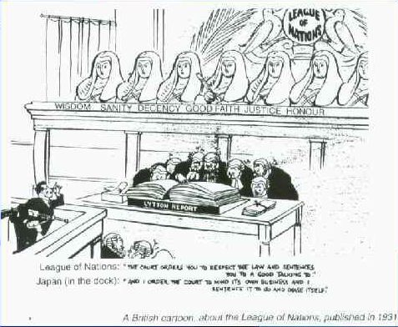
The Health Organization of the League of Nations (1923)
The League of Nations was a failure on political side, its health organization which was established in 1923 did creditable work.
Quarantine regulations and epidemiological information or even larger problems of epidemic diseases, the Health Organization of the League branched out into such matters as nutrition, housing and rural hygiene, the training of public health workers and the standardization of certain biological preparations.
The League analysed epidemiological information received, and started the series of periodical epidemiological reports now issued by the WHO.

Slide 12
The Health Organization of the League of Nations (1923)
It laid down lines for technical studies (including the use of expert committees) which are substantially followed by the WHO The WHO owes much to the work done and methods devised by the Health Organization of the League.
Efforts to amalgamate the OIHP, PASB and the Health Organization of the League of Nations proved a failure, and all the three organizations were co-existing during the years between the two World Wars.
In 1939, the League of Nations was dissolved but its Health Organization in Geneva continued to deal as best it could with requests for information and the publication of the Weekly Epidemiological Records was never suspended.

Slide 13

The United Nations Relief and Rehabilitation Administration (1943)
Organizing recovery from the effects of the Second World War.
Care for the health of the millions of displaced persons, to restore and help services and to revive the machinery for international interchange of information on epidemic diseases.
Outstanding work of preventing the spread of typhus and other diseases, so that they never reached serious epidemic levels anywhere.

Slide 14

The United Nations Relief and Rehabilitation Administration (1943)
Similarly, UNRRAS assistance to malaria control in such countries as Greece and Italy, where war had disrupted peace-time anti-malaria services, was on an immense scale. The world renowned campaign for the eradication of malaria from Sardinia was begun as a joint effort of UNRRA, the Rockefeller Foundation and the Italian Government.
At the end of 1946, UNRRA terminated its official existence and its health activities and financial assets were taken over by the Interim Commission on the WHO

Slide 15
World health organization - origin
April 1945, during the conference held at San Francisco to set up the United Nations.
The representatives of Brazil and China proposed that an international health organization should be established and that a conference to frame its constitution should be convened.
The constitution was drawn up at an international health conference in New York in 1946. The same conference set up an “Interim Commission to prepare the ground for the new organization and to carry out urgent tasks until the WHO constitution had been accepted by the required number of UN Member States.

Slide 16
World health organization - origin
Specialized, nonpolitical, health agency of the United Nations, with headquarters at Geneva. In 1946, the Constitution was drafted by the “Technical Preparatory Committee’' under the chairmanship of Rene Sand, and was approved in the same year by an International Health Conference of 51 nations in New York.
The constitution came into force on 7th April, 1948 which is celebrated every year as “World Health Day”.
A World Health day theme is chosen each year to focus attention on a specific aspect of public health.

Slide 17

WHO
Unique among the UN Specialized Agencies in that it has its own constitution, own governing bodies, own membership and own budget. It is part of, but not subordinate to, the United Nations.
Two major policy developments have influenced the WHO.
First, the Alma-Ata Conference in 1978 on primary health care which provided both WHO and UNICEF with a common charter for health,
Secondly, the Global Strategy for Health for All by 2000, and more recently Millennium Development Goals; further on SDG

Slide 18

WHO
Objective - the attainment by all people's of the highest level of health” which is set out in the preamble of the Constitution. The current objective of WHO is the attainment by all people of the world a level of health that will permit them to lead a socially and economically productive life.

Slide 19
WHO – preamble of constitution
Health is a state of complete physical, mental andsocial well-being and not merely the absence of disease or infirmity.
The enjoyment of the highest attainable standard of health is one of the fundamental rights of every human being without distinction of race, religion, political belief, economic and social condition.
The health of all peoples is fundamental to the attainment of peace and security and is dependent upon the fullest cooperation of individuals and States.
The achievement of any State in the promotion and protection of health is of value to all.
Unequal development in different countries in the promotion of health and control of disease, especially communicable disease, is a common danger.

Slide 20
WHO – preamble of constitution
Healthy development of the child is of basic importance; the ability to live harmoniously in a changing total environment is essential to such development.
The extension to all people of the benefits of medical, psychological and related knowledge is essential to the fullest attainment of health.
Informed opinion and active cooperation on the part of the public are of the utmost importance in the improvement of the health of the people.
Governments have a responsibility for the health of their peoples which can be fulfilled only by the provision of adequate health and social measures

Slide 21
WHO - membership
Membership in WHO is open to all countries.
While most countries are members of both the UN and of WHO, there are some differences. For example, Switzerland is a member of WHO, but not of the United Nations.
Territories which are not responsible for the conduct of their international relations may be admitted as associate members.
Associate members participate without vote in the deliberations of the WHO.
Each member state contributes yearly to the budget and each is entitled to the services and aid the organization can provide.
In 1948, the WHO had 56 Members. WHO now has 194 member states and two associate members.

Slide 22
Work of WHO
Prevention & control of specific disease
Small pox, polio-myelitis
Epidemiological surveillance of communicable disease
Non-communicable disease
Vector biology and control, immunology, quality control of drugs
Development of comprehensive health services
Promote and support national health policy development
Development of comprehensive national health programmes
Organizing health systems – PHC, manpower and utilization, longterm national capability, infrastructural development
Appropriate technology for health

Slide 23
Work of WHO
Family health
Since 1970
MCH, human reproduction, nutrition and health education
Environmental health
Protection of the quality of air, water and food; health conditions of work, radiation protection and early identification of new hazards originating from new technological developments.
‘WHO Environmental Health Criteria Programme’ and ‘WHO Environmental Health Monitoring Programme’
Health statistics
Weekly Epidemiological Record
World Health Statistics Quarterly
World Health Statistics Annual

Slide 24
Work of WHO
Biomedical research
Does not itself do research, but stimulates and coordinates research work. It has established a world-wide network of WHO collaborating centres, besides awarding grants to research workers and research institutions for promoting research.
Six tropical diseases (malaria, schistosomiasis, trypanosomiasis, filariasis, leishmaniasis and leprosy) are the target of the WHO Special Programme for Research and Training in Tropical Diseases to develop new tools, strengthen research institutions and training workers in the countries affected.
Health literature and information
WHO library is one of the satellite centres of the Medical Literature Analysis and Retrieval System (MEDLARS) of the U.S National Library of Medicine
Cooperation with other organization

Slide 25
Structure
World health assembly
Health parliament of nations and supreme governing body
Annual meet – Geneva
To determine international health policy and programmes
To review the work of the past year
To approve the budget needed for the following year
To elect Member States to designate a person to serve for three years on the Executive Board, and to replace the retiring members.
The Health Assembly also appoints the Director General on the nomination of the Executive Board.

Slide 26
Structure
Executive board
Originally 18 members, each designated by a Member State.
Subsequently, the number was raised to 24 and 30.
The Health Assembly (1976) increased the membership from 30 to 31, providing that no fewer than three are to be elected from each of the WHO regions (11). The board now has 34 members. The members of the Board are to be “technically qualified in the field of health ;
They are designated by, but do not represent their governments.
One-third of the membership is renewed every year.
The Executive Board meets at least twice a year, generally in January and shortly after the meeting of the World Health Assembly in May.
The Board also has power to take action itself in an emergency, such as epidemics, earthquakes and floods where immediate action is needed.

Slide 27
Structure
Secretariat
Director General who is the chief technical and administrative officer of the Organization.
The primary function of the WHO secretariat is to provide Member States with technical and managerial support for their national health development programmes.
While in 1948, WHO staff counted 250 persons, the Organization in 1985 counted 4475 international public servants. The secretariat, by 2010, is staffed by about 8000 health and other experts and support staff.
At WHO headquarters in Geneva, there are 5 Assistant Director Generals each of whom is responsible for the work of such divisions as may from time to time be assigned to him by the Director General

Slide 28
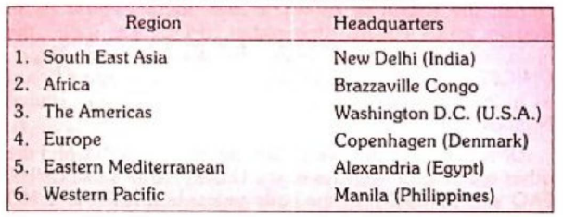
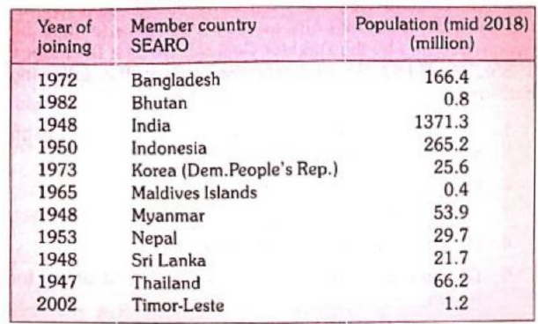
Regions
Headed by the Regional Director, who is assisted by technical and administrative officers, and members of the secretariat.
There is a regional committee composed of representatives of the Member States in the region.
Regional Committees meet once a year to review health work in the region and plan its continuation and development.
Regional plans are amalgamated into overall plans for the Organization by the Director General at WHO’s headquarters in Geneva.

Slide 29
PHEIC
There are four criteria for declaring a PHEIC:
Seriousness of the public health impact of the event.
Unusual or unexpected nature of the event.
Potential for the event to spread internationally.
The event may require immediate international action.
It’s also understood that for an event to be considered a PHEIC, it must meet three core criteria:
Be considered extraordinary.
Constitute a public health risk to other states through the spread of disease.
Require a coordinated international response.

